Slide 1

Test Preparation and
Test Taking
How do you use test preparation and memory to aid your test taking skills.

Slide 2

What it Test Anxiety?
Test anxiety is really a type of performance anxiety similar to situations where someone feels anxious or pressure to do well in a particular situation.
Three types of text anxiety:
Cognitive – what you are thinking
Behavioral – what you are feeling and how you act on it
Physiological – how it affects you physically

Slide 3
Cognitive Test Anxiety
Common symptoms:
Regularly comparing yourself to others, Brain fog or cannot remember, Dread of failure, Self pressure to perform better then others, Negative thoughts about past performance, Negative thoughts about self

Slide 4
Behavioral Test Anxiety
Common symptoms:
Excessive fear, Depression or sadness, Self shame or shaming or others, Anger towards self or instructor/test administrator, Extreme disappointment of self and not able to move on or recover from it

Slide 5
Physiological Test Anxiety
Common symptoms:
Nausea, Dizziness, Difficulty breathing, Headaches, Muscle pain or tension, Excessing sweating, Feeling of being hot or overly warm

Slide 6
Find your
“Study Niche” and use it!
Niche – A position or activity that suits your talents and/or personality that makes something your own.
“Study Niche” – Your ability to retain content through individual, group, quietness, noise-filled and/or location based study habits.

Slide 7

Ways to Overcome Test Anxiety - Before
Study efficiently - (quiet setting/prioritize/take breaks)
Study early and often – helps with memory retention
Group study – discuss with other students
Take detailed notes and utilize them
Be in frequent contact with instructor – ask questions and discuss content
Get plenty of sleep before exam
Eat nutritiously – high protein/plenty of water
Get to testing site early
Challenge self to do best – not perfection
Breathing exercises/meditation

Slide 8
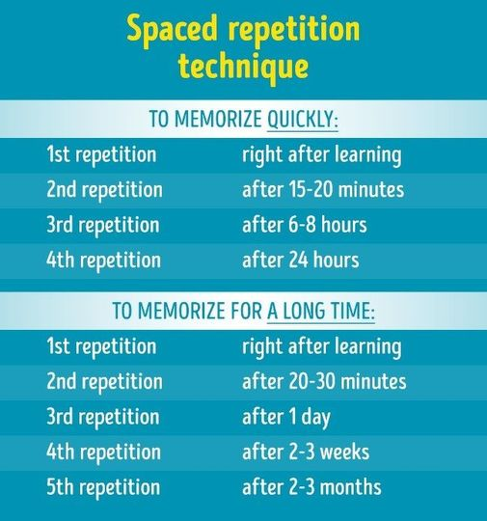

How to memorize

Slide 9

Ways to Overcome Test Anxiety - During
Read test material carefully/follow instructions thoroughly
Keep track of time during exam
Tackle easier questions first
Flag questions you are unsure of to return to later
Make sure understand question before choosing answer
Use scratch paper (if allowed) to help organize thoughts
Ignore those that finish exam early – early does not always mean correct
Check over exam before submitting to make sure all questions answered, etc.

Slide 10
Review and Reward
After exam, review what helped you before, during and after exam
Pull positive traits and utilize them for future study and exam taking techniques.
Always be willing to learn from good or bad results
Reward yourself for your hard work and commit to future study habits.
SUCCESS WILL FOLLOW!!

Slide 11
Review - Ways to Overcome Test Anxiety
Study efficiently - (quiet setting/ prioritize/take breaks)
Study early and often – helps with memory retention
Group study – discuss with other students
Be in frequent contact with instructor – ask questions and discuss content
Get plenty of sleep before exam
Eat nutritiously – high protein/plenty of water
Get to testing site early
Challenge self to do best – not perfection
Breathing exercises/meditation
Read test material carefully/follow instructions thoroughly
Keep track of time during exam
Tackle easier questions first
Flag questions you are unsure of to return to later
Make sure understand question before choosing answer
Use scratch paper (if allowed) to help organize thoughts
Ignore those that finish exam early – early does not always mean correct
Check over exam before submitting to make sure all questions answered, etc.

Slide 12
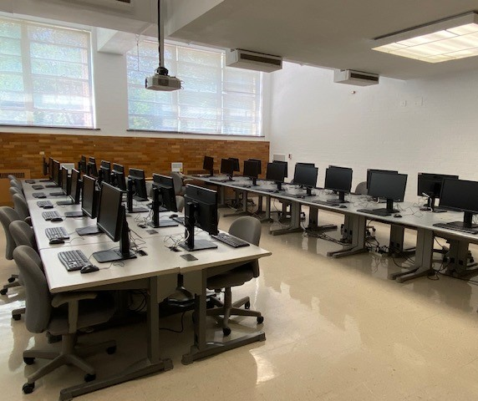
Testing and Evaluation Operations (TEO)
TEO computer lab is located in McAfee 1341. TEO supports the educational mission of the University by providing high quality testing, exam scoring, evaluation and survey services for faculty, students, and staff as well as a testing environment for students requiring accommodations.
TEO also provides testing services to the local community. Services for all constituents are provided in a professional, secure and accessible environment that supports academic success.
Exams offered include but not limited to:
  Math placement exams (MPE) - placement into EIU math course
  Reading placement exams (RPE) - placement into EIU ENG course
  ACT Residual exam
    Admissions exam for EIU - ONLY
    Also utilized for EIU Merit Scholarships
Outside proctored exams - administered for other colleges and/or universities to EIU students and/or community members for a fee.
Faculty/Course/Advisor Evaluations - End of semester evaluations either online or F2F administration – Your turn to let EIU know how we can better serve you as a student and part of our EIU family.
Notes:
TES supports the educational mission of the University by providing high quality testing, exam scoring, evaluation and survey services for faculty, students, and staff. In addition, TES provides testing services to the local community. Services for all constituents are provided in a professional, secure and accessible environment that supports academic success.

Slide 13
Testing and Evaluation Operations
McAfee Gym Building – Suite 2000
Phone – 217-581-6696
Carrie Gossett, Director
cegossett@eiu.edu
Brandy Verdin, Office Manager
bkverdin@eiu.edu
Debra Coartney, Testing Coordinator
djcoartney@eiu.edu

